Slide 1

DSC530 Final Project
Cody Myers
Bellevue University
Summer 2020

Slide 2
Question
For this project, I am looking to take a deeper dive into the NSFG pregnancy data set. I would like to see if there is a relationship between a respondents socio-economic status, the outcomes of their pregnancies, and the number of times the respondents becomes pregnant.

Slide 3
Variables
The variables chosen below are based on answering some questions I have regarding the NSFG data. I felt that we didn’t tap into wealth of data that this data source had to offer. I wanted to look at how much a person’s social life and upbringing had to do with the number of times someone became pregnant.
caseid | poverty
religion | educat
pregoutcome | pregnum

Slide 4
Variables (cont.d) - Reasoning behind each variable
Caseid
To be used for identifying unique records in the data set.
Poverty
This will be used to understand the economic status of those involved in the study.
Religion
Determines the religious affiliation of the respondent (if any).
Educat
Number of years the respondent has had of formal education.
Prgoutcome
The success or failure of a pregnancy.
Pregnum
The number of times the respondent has been pregnant.

Slide 5
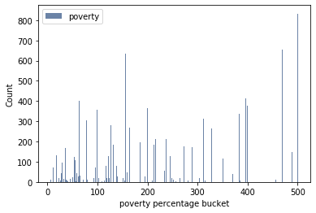
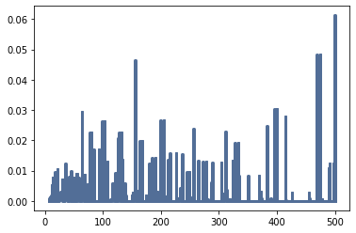
Poverty Variable Histogram and PMF plot

Slide 6
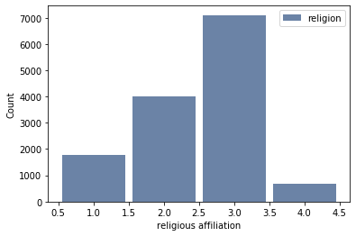
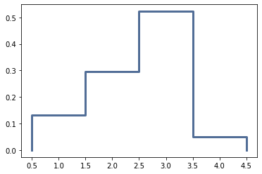
Religion Variable Histogram and PMF plot

Slide 7
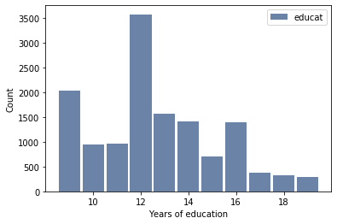
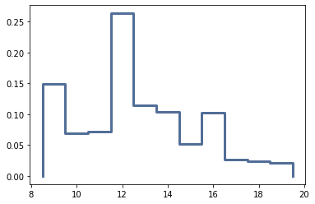
Education Variable Histogram and PMF plot

Slide 8
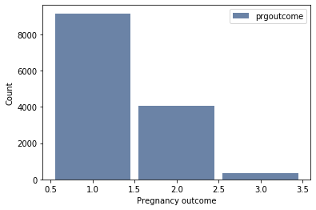
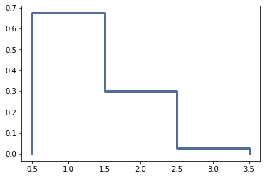
Pregoutcome Variable Histogram and PMF plot

Slide 9
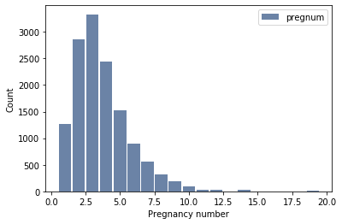
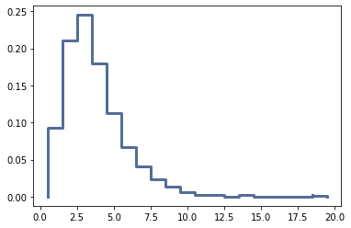
Pregnum Variable Histogram and PMF plot

Slide 10
Statistical Summary
 | poverty | religion | educat | prgoutcome | pregnum
mean | 219.226146 | 2.491062 | 12.664680 | 1.351088 | 3.698301
min | 7.000000 | 1.000000 | 9.000000 | 1.000000 | 1.000000
max | 500.000000 | 4.000000 | 19.000000 | 3.000000 | 19.000000
median | 180.000000 | 3.000000 | 12.000000 | 1.000000 | 3.000000
skew | 0.524108 | -0.480107 | 0.424114 | 1.141946 | 1.617534

Slide 11
CDF and understanding

